Slide 2
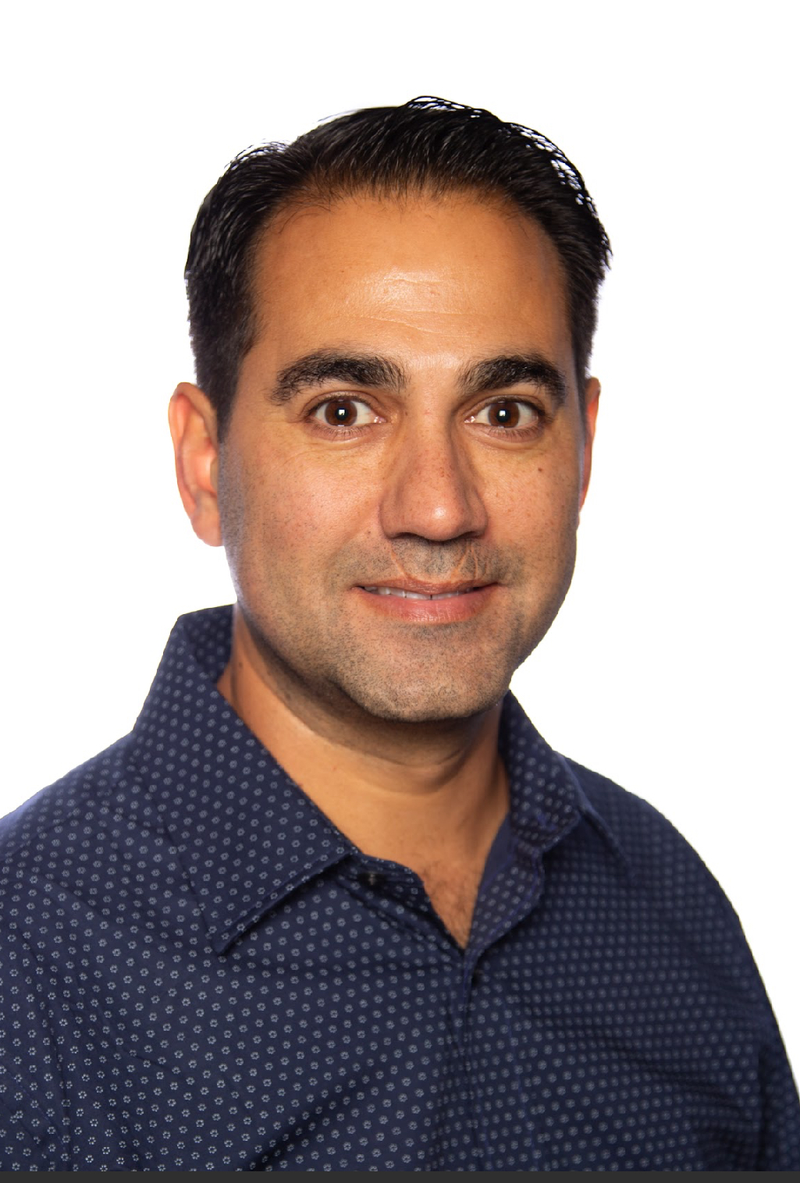
Justin Sider Chief Information Officer Belay Technologies
Invoke-VCF –Version 9 InstallType Full –Confirm:$false

Slide 3


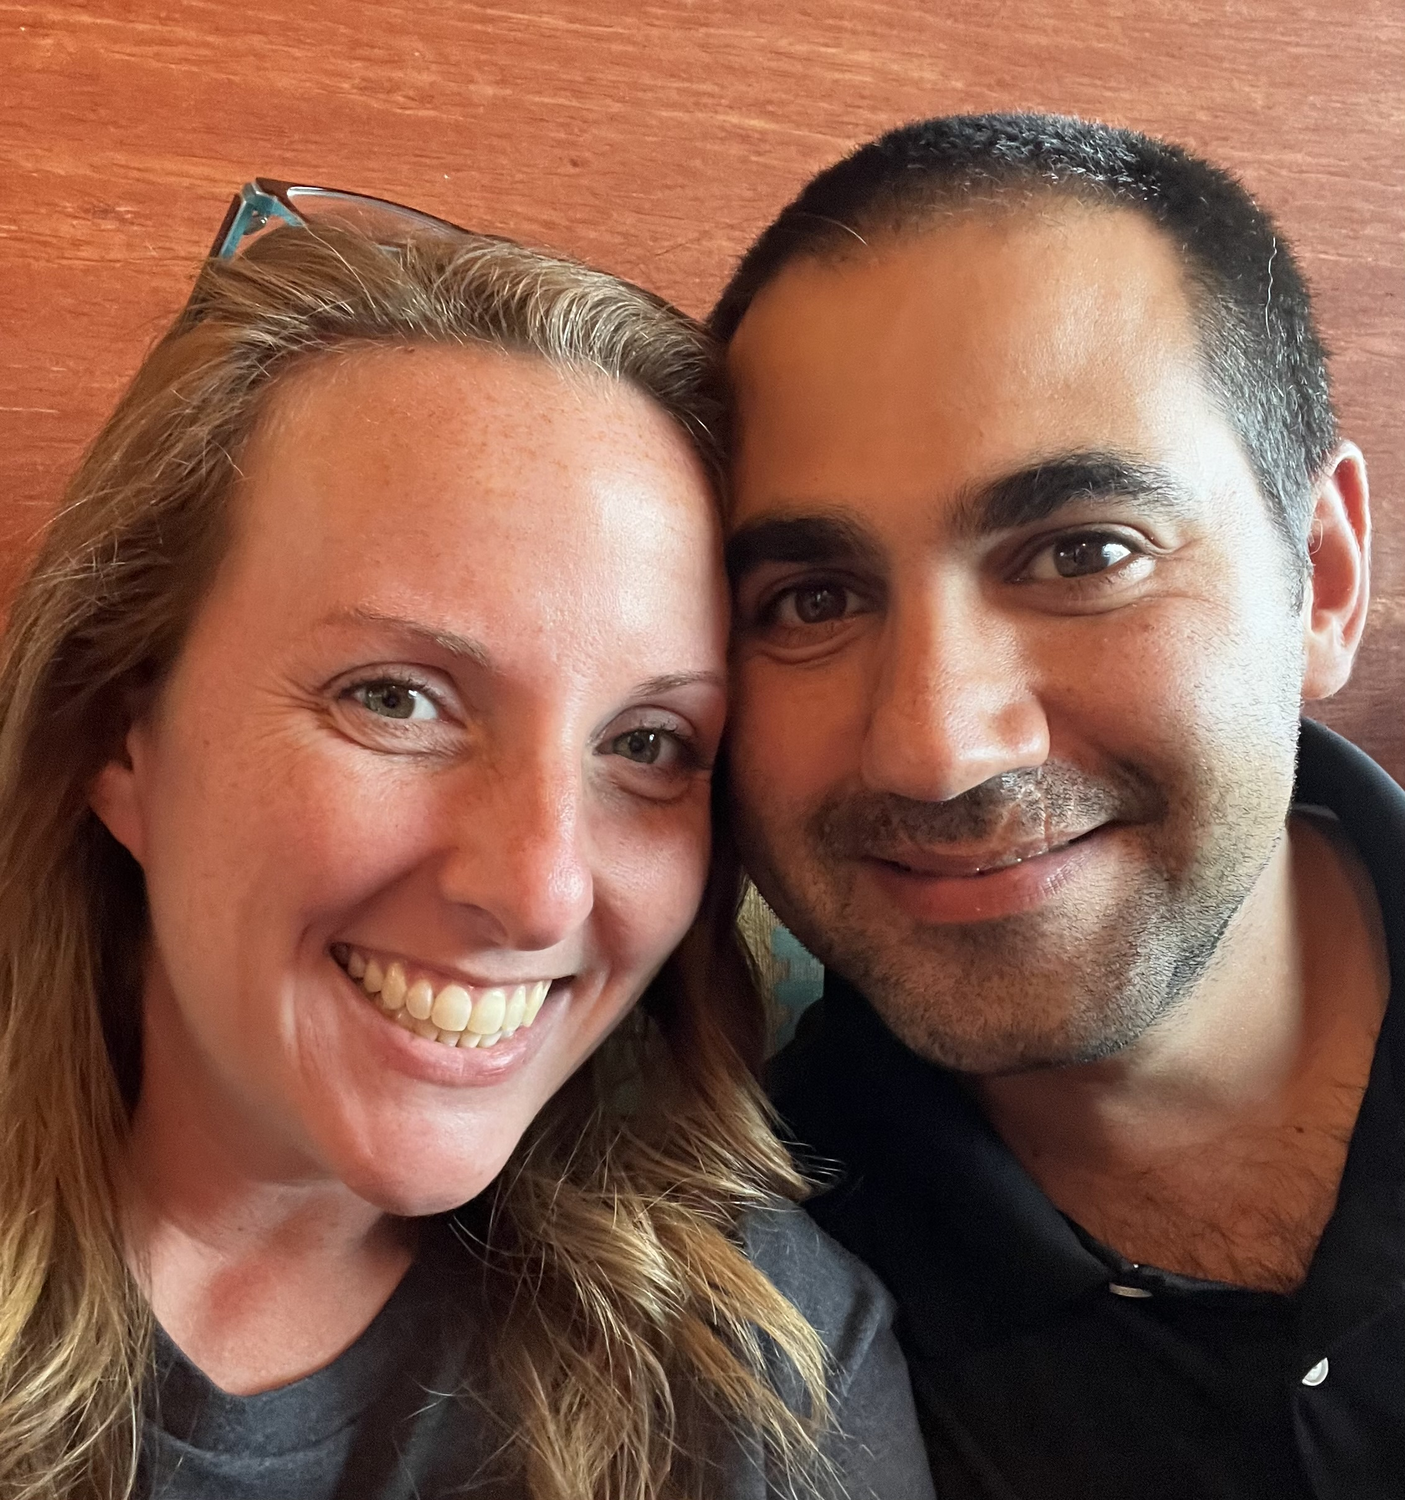
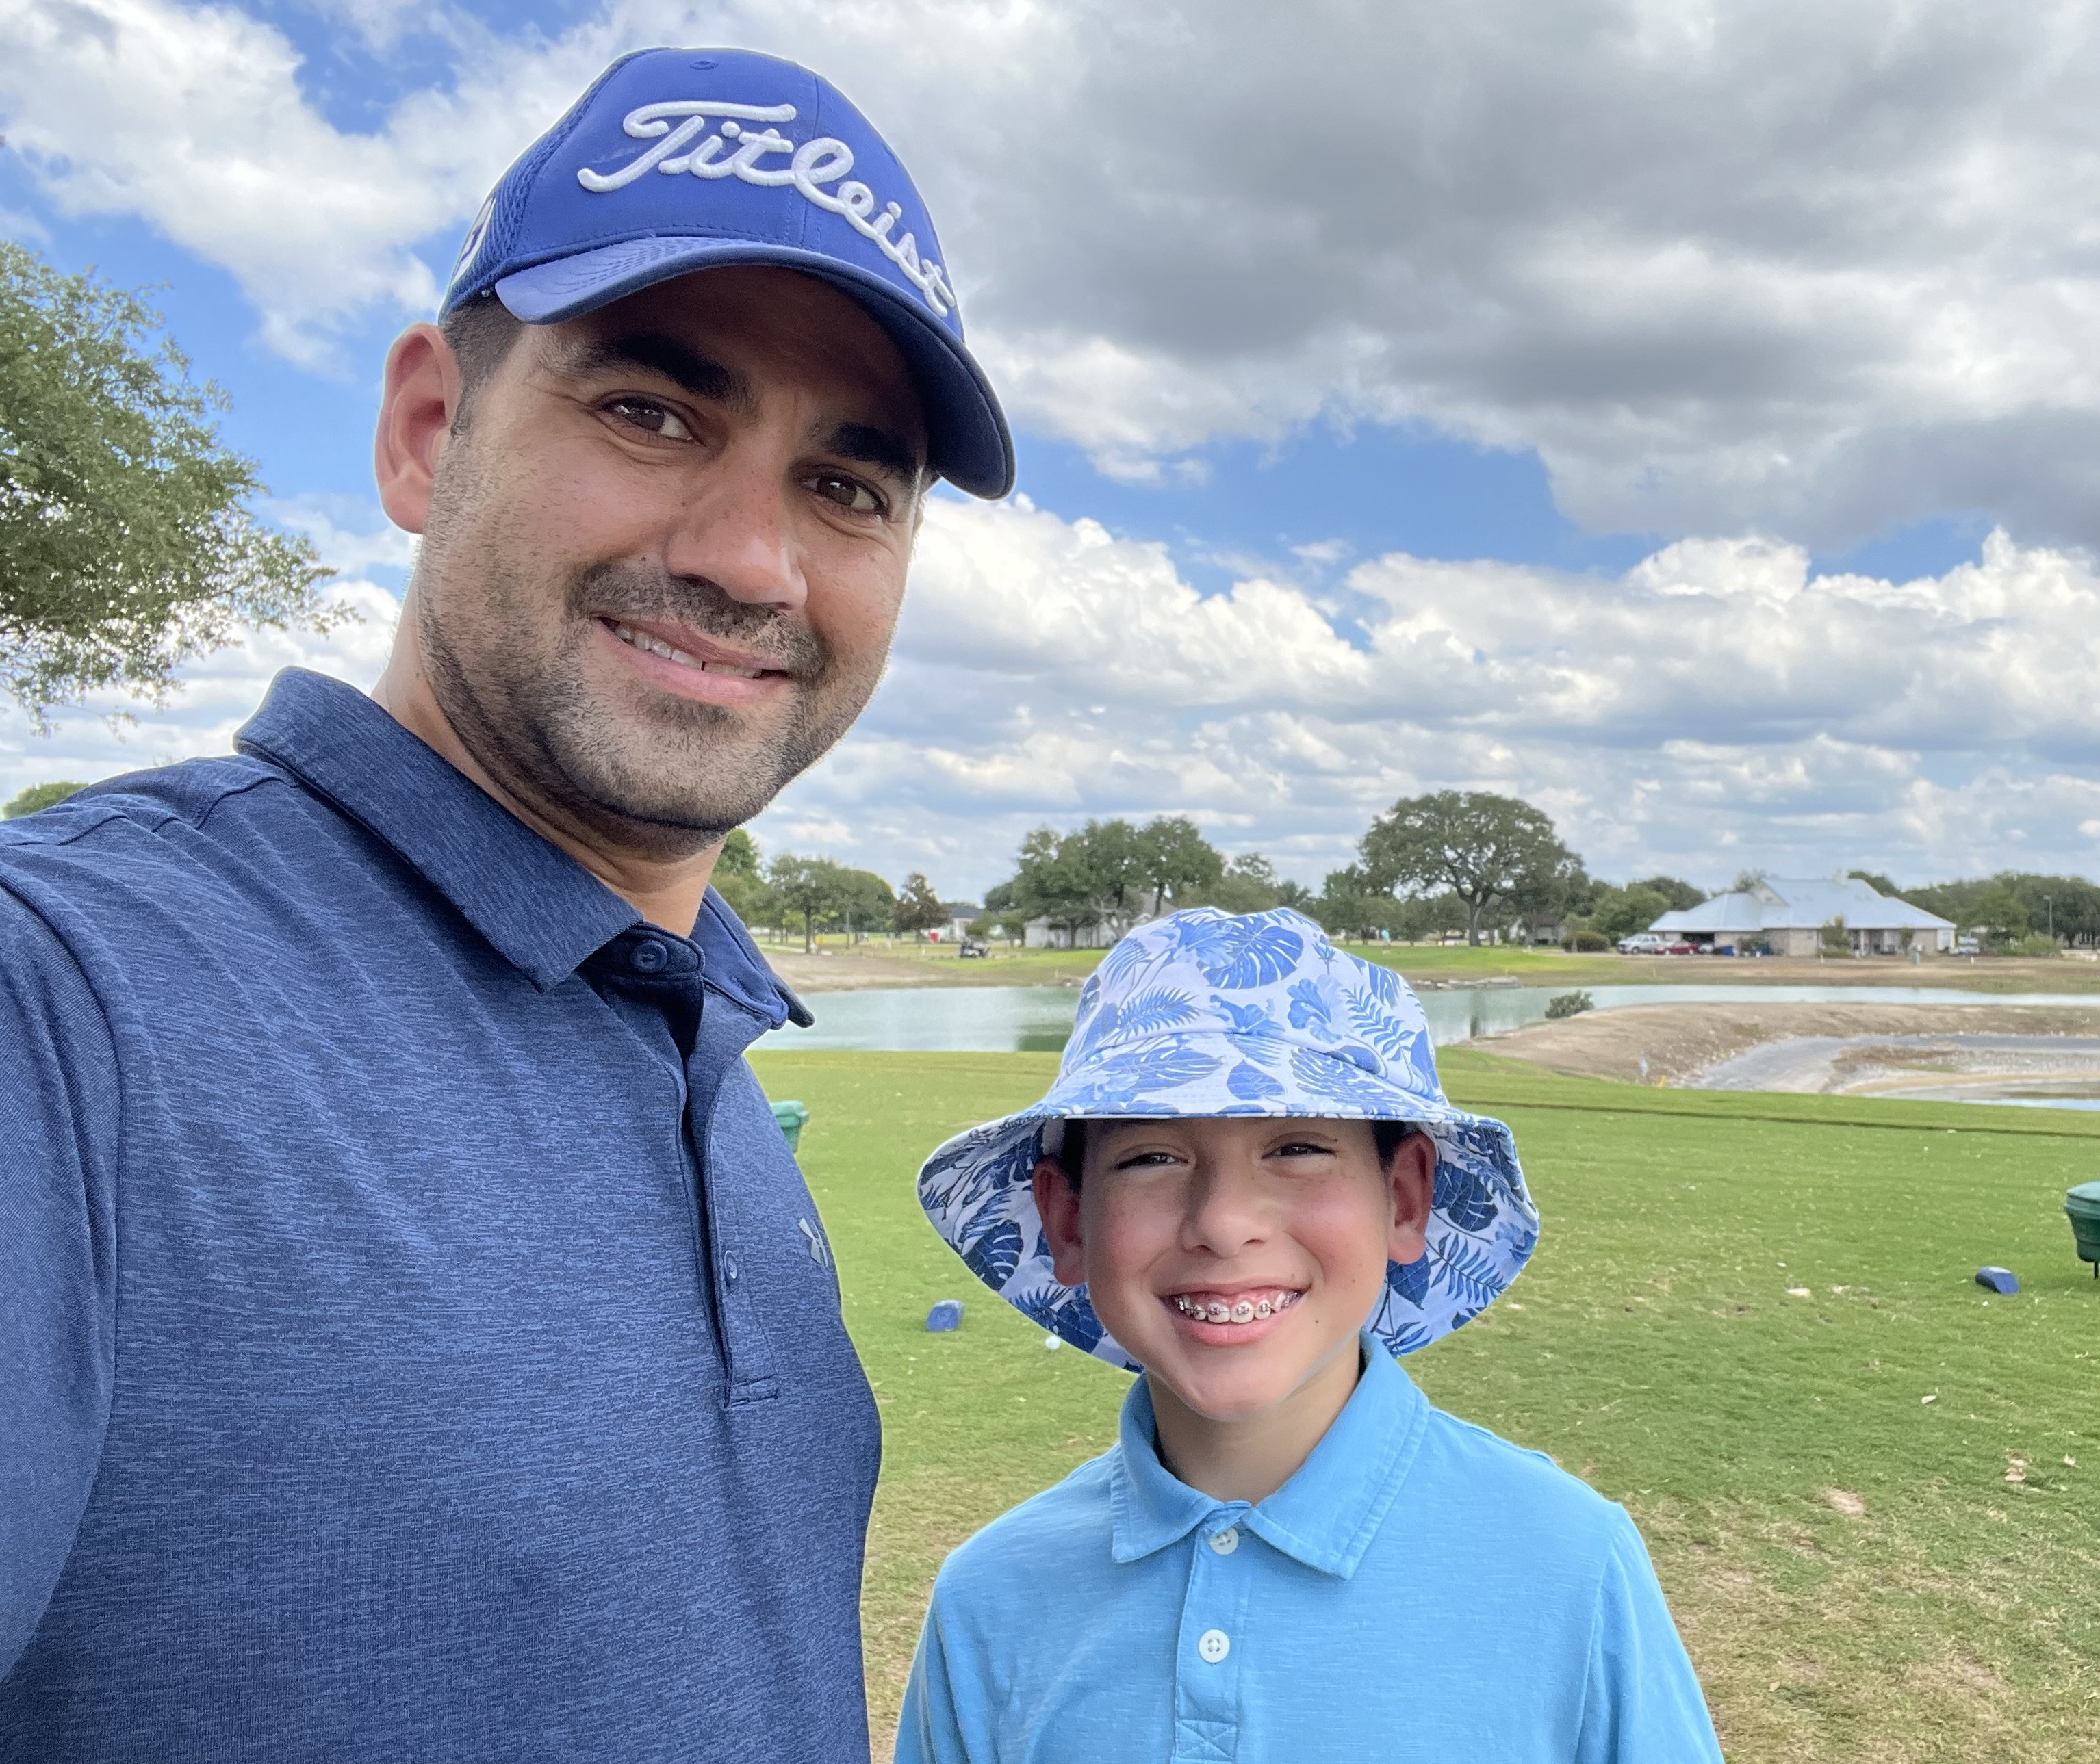
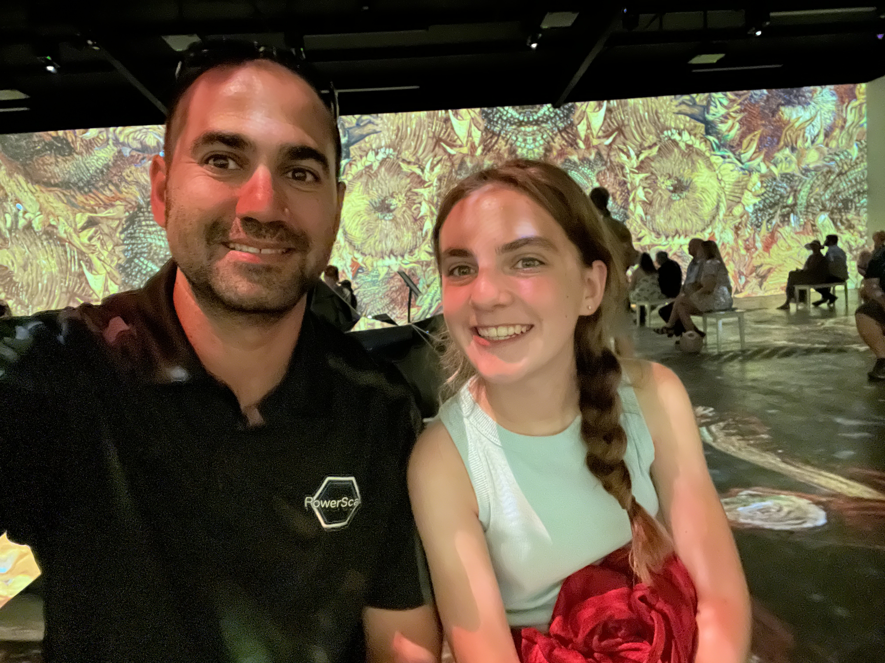
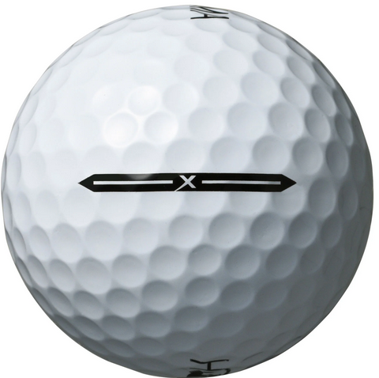
About me
Blog
Invoke-automation.blog
Twitter(X)/Slack/GitHub
jpsider
VMware Programs
VMUG Advantage
VMUG Board of Directors
vExpert x10
VMware {Code} Coach

Slide 4
Invoke-VCF –Version 9 –InstallType Full –Confirm:$False
Tune in to this Virtual session to learn about how Belay Technologies took a programmatic approach to evaluating and planning how we will deploy VCF. During the session,
I give an overview of the current deployment architecture of our current infrastructure and review the differences as we deploy VCF in a greenfield environment.
The session will cover key decision points that will allow our team to take full advantage of the VCF software suite to ensure we get the best bang for the buck.

Slide 5
Agenda
About Belay’s Workloads
Current Deployment
Future Deployment (VCF)
VCF Considerations

Slide 6
Belay’s Workloads
Automated Range Testing
Provisioning Engine
Task Execution Engine
Think along the lines of VMware Hands on Labs
SummitRTS.com

Slide 7
Current Deployment
VMware Products
vCenter
ESXi
NSX
LogInsight
Kubernetes
Rancher

Slide 8
Draw a picture

Slide 9
VCF Deployment
VMware Products
vCenter
ESXi
NSX
LogInsight
Aria Automation
Tanzu

Slide 10
Draw a picture

Slide 11
VCF Considerations
Available Products

Slide 12
VCF Considerations
VCF vs. VVF

Slide 16





